Slide 1
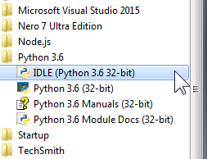
Installing Python
Installing Python is easy…
Browse to Python's website and choose the appropriate download based on your operating system: https://www.python.org
Proceed to install Python. If you're on a PC running Windows for instance, double-click the .exe file and proceed through the installation. I typically prefer to install Python at the root of c:\ to make the Python .exe easier to find later.
Verify that Python (and associated tools) have been installed on your computer.

